Slide 1
Intersections between the Movement for a National Health Program and the Fight for Racial Justice
Lily Ostrer (M2), Charlotte Austin (M2),
Ebiere Okah (Scholarly Year), Salman Ahsan (M2)
Icahn School of Medicine at Mount Sinai

Slide 2
History
“It is also in part the history of racism, with which President Roosevelt had to come to terms to get his New Deal programs past Southern Democrats in Congress who insisted on control over who got welfare and how much.”
"Truman's linking of civil rights and health insurance…. exacerbated southern fears that a national program would challenge the racial segregation of health services in the South.”
“But unlike Britain, France or Canada, the United States of 1947 had a peculiar feature -- a large, Apartheid state in the South which since the aftermath of the Civil War had sought to deprive the newly-freed black population of their rights through discrimination and terror”
“Southern politicians figured that Truman's proposals for national health insurance would mean federally-funded hospitals where black patients would be treated alongside whites”

Slide 3
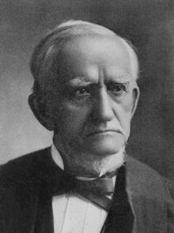
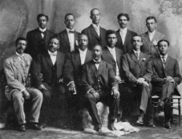
Race and the AMA
Nathan Smith Davis
NNMA Ohio Chapter, 1909
Notes:
http://journalofethics.ama-assn.org/2014/06/mhst1-1406.html
http://www.aaregistry.org/historic_events/view/national-negro-medical-association-begins
Nathan Smith Davis, self-styled “father” of the AMA, objected to the committee’s recommendation. Injecting race into a discussion initially about gender, Davis argued that admission standards with respect to “sex or color” should be left to local societies and those denied membership “should not claim the legislative power of this Association to pass ex post facto laws for their especial benefit” [4]. Having stipulated that local medical societies should have a right to enact segregationist or sexist admission standards without interference from the national society, Davis moved that the matter be indefinitely postponed [5]
http://www.ama-assn.org/ama/pub/about-ama/our-history/race-ama-a-chronology.page?
Both the AMA and ANA prohibited individual membership for much of their early history. This requirement was exloted in the early 20th century by feeder medical societies on the local level in the JIM Crow South that used this stipulation to justify excluding black health professionals. Meaning a health worker had to join a local society to join the AMA< direct individual membership was not permitted.
This professional discrimination had serious repercussions for black doctors and nurses, who were often required to be members of the national organizations in order to be granted hospital privileges and who needed these memberships for professional development opportunities.
Although the AMA leadership was willing to pass resolutions stating that the body did not discriminate, and did so well into the 1960s, it demurred when asked to take a hard line against segregation and refused to penalize or sanction local affiliated that excluded black doctors.
It took protests for AMA to change.1963 June: MCCR demanded AMA be more forthright in opposition, picketed 1963 meeting. 1965 was still segregated, 200 protestors from MCHR turned out at the annual AMA meeting in NYC, and then twice as many 1966 in Chicago. Only then did AMA work with southern affiliates adhered to the theoretical antisegreation laws of AMA.

Slide 4
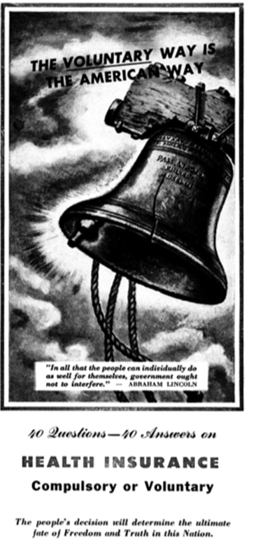
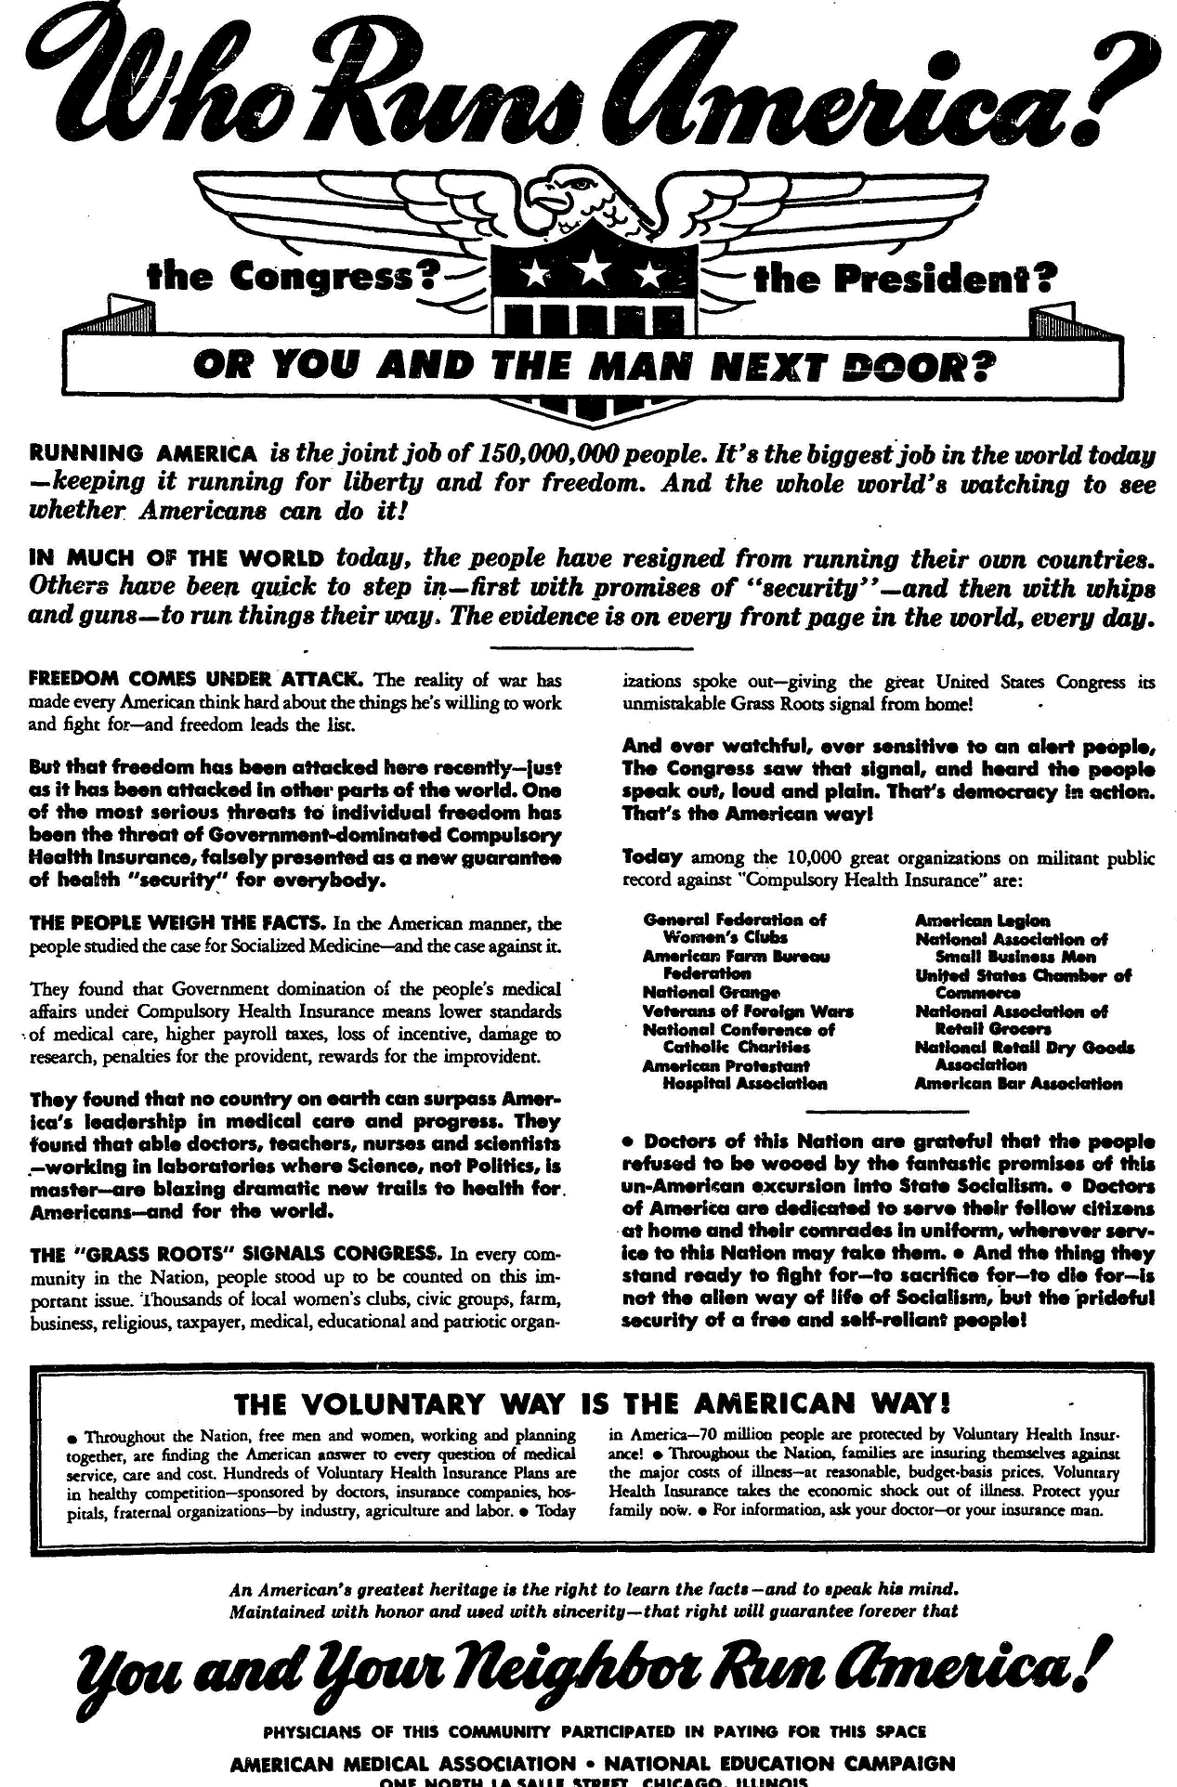
Notes:
example of propaganda by AMA against national healthcare from 1950
http://umhm.mededu.miami.edu/?p=394

Slide 5
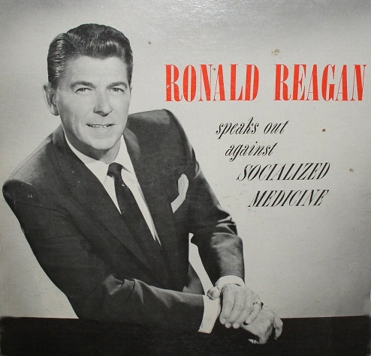
Operation Coffee Cup
Notes:
Operation Coffee Cup was a campaign conducted by the American Medical Association (AMA) during the late 1950s and early 1960s in opposition to the Democrats' plans to extend Social Security to include health insurance for the elderly, later known as Medicare. As part of the plan, doctors' wives would organize coffee meetings in an attempt to convince acquaintances to write letters to Congress opposing the program. The operation received support from Ronald Reagan, who in 1961 produced the LP record Ronald Reagan Speaks Out Against Socialized Medicine for the AMA, outlining arguments against what he called socialized medicine.

Slide 6
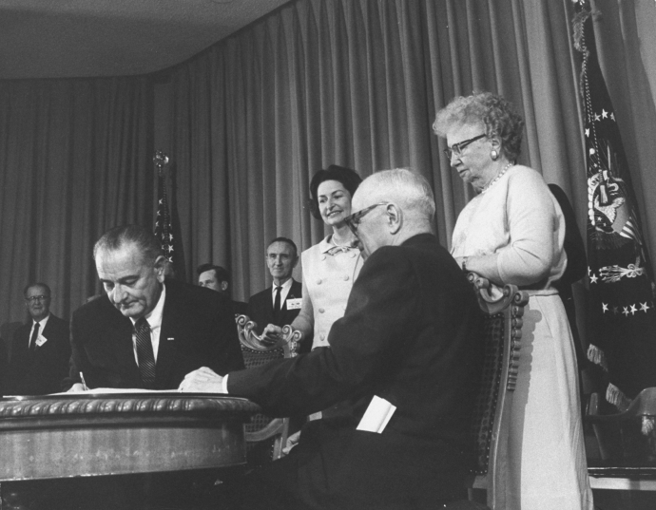
Notes:
Lady Bird Johnson, former President Harry Truman, and Bess Truman look on as President Lyndon Johnson signs Medicare into law
http://www.newyorker.com/news/news-desk/medicare-made

Slide 7
Racism and Policy
Racism → Media Representation → Public Perception→ Policy

Slide 8
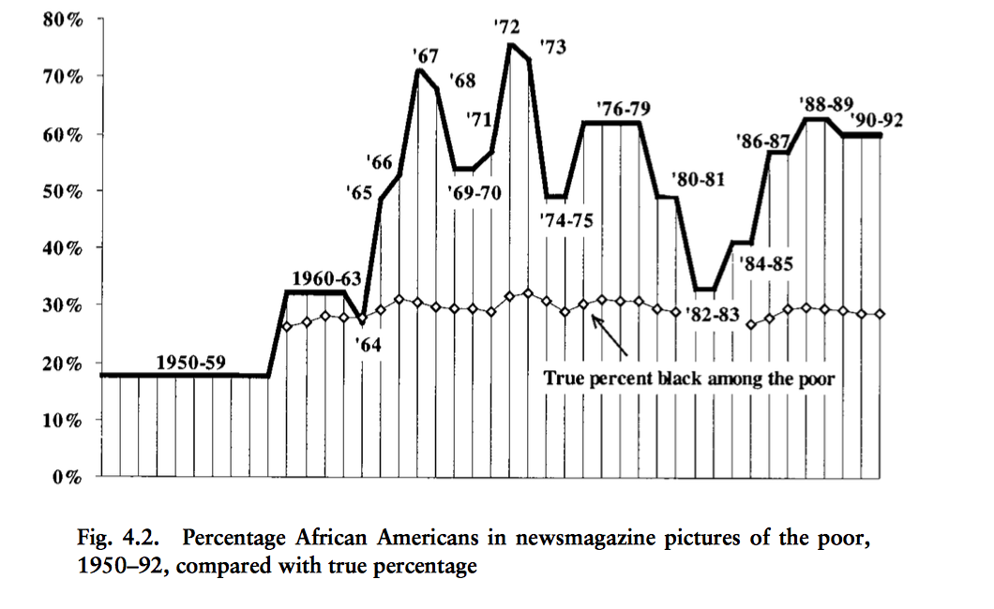
Changing Face of Poverty
“welfare mess”
War on poverty begins
Recessions
Source: Gilens, M. How the poor became black. Race and the Politics of Welfare Reform.

Slide 9
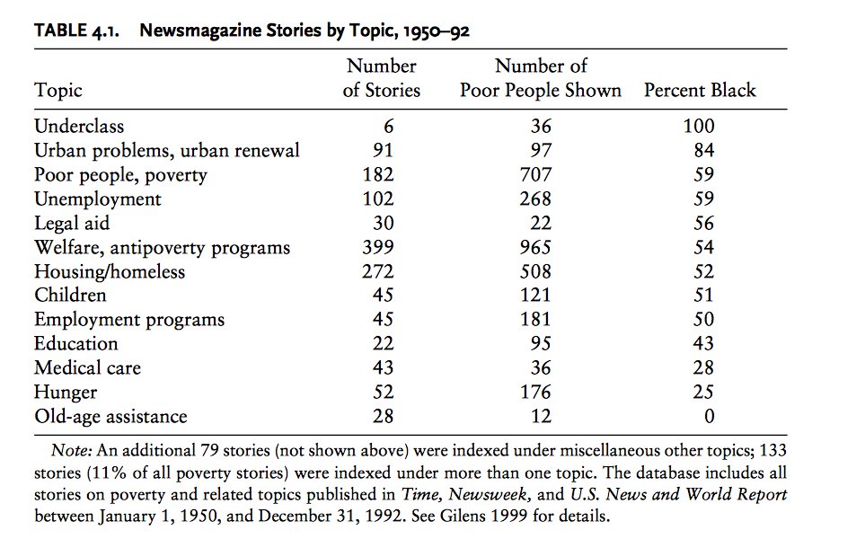
Poverty, Sympathy and Race
Source: Gilens, M. How the poor became black. Race and the Politics of Welfare Reform.

Slide 10
ACA, 2010
Composed of two laws:
Patient protection and Affordable Care Act
Health Care and Education Reconciliation Act of 2010
Increase both private and public insurance, reducing the number of uninsured

Slide 11
ACA and Race
Right-wing pundits link ACA to anti-white agenda
“Racial prejudice predicts opposition to Obama and his health care reform plan”
“Racism undermines support for government spending”
Notes:
https://www.washingtonpost.com/blogs/plum-line/wp/2014/05/23/yes-opposition-to-obamacare-is-tied-up-with-race/
http://www.sciencedirect.com/science/article/pii/S0022103109002649
http://america.aljazeera.com/opinions/2016/2/racism-undermines-support-for-government-spending.html

Slide 12
Medicaid Expansion
Original law required expansion to anyone making less than 138% of federal poverty level
Federal government covers all costs of expansion until 2016, then 90% of costs after that
Supreme court struck down the “required” expansion allowing states to decide

Slide 13
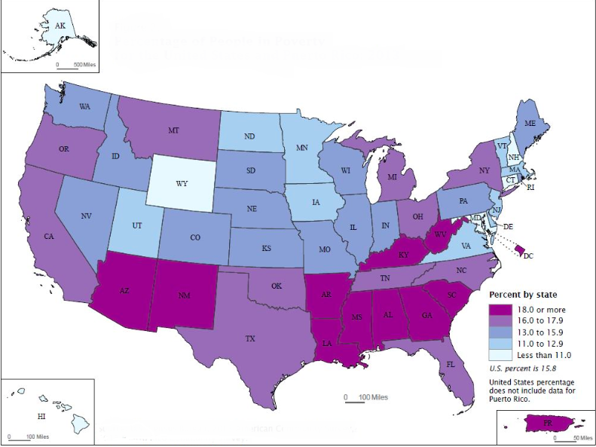
Poverty Rate, 2013
￼
￼

Slide 14
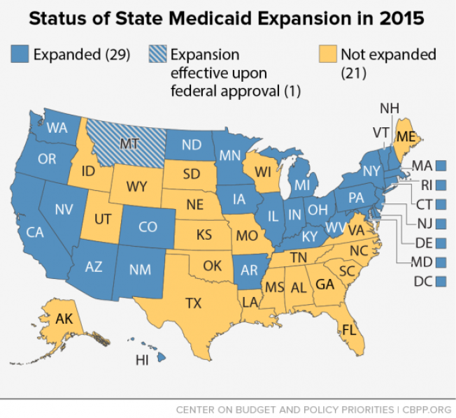

Slide 15
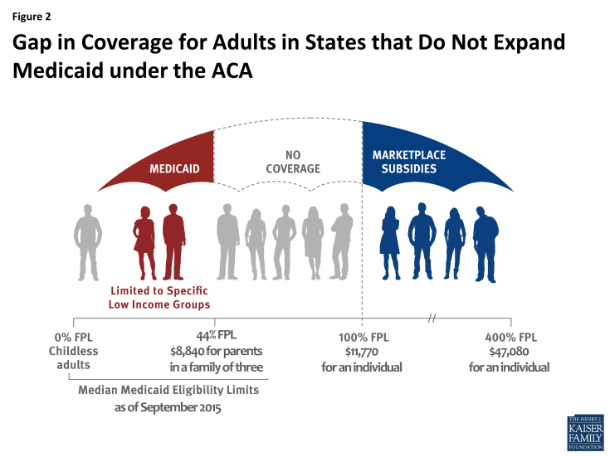
The Coverage Gap
Source: Kaiser Family Foundation

Slide 16
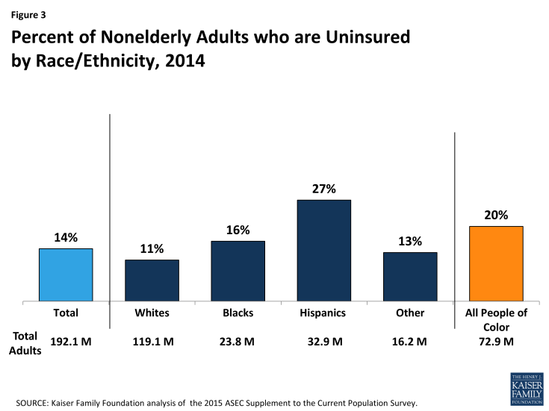
Racial Disparities in Coverage
Source: Kaiser Family Foundation

Slide 17
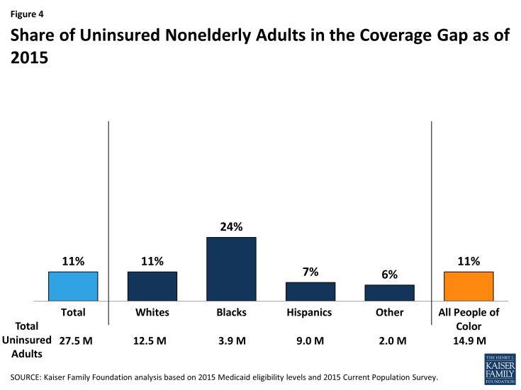
Race and Coverage Gap
Source: Kaiser Family Foundation
Notes:
Blacks are disproportionately in states that did not expand medicaid

Slide 18
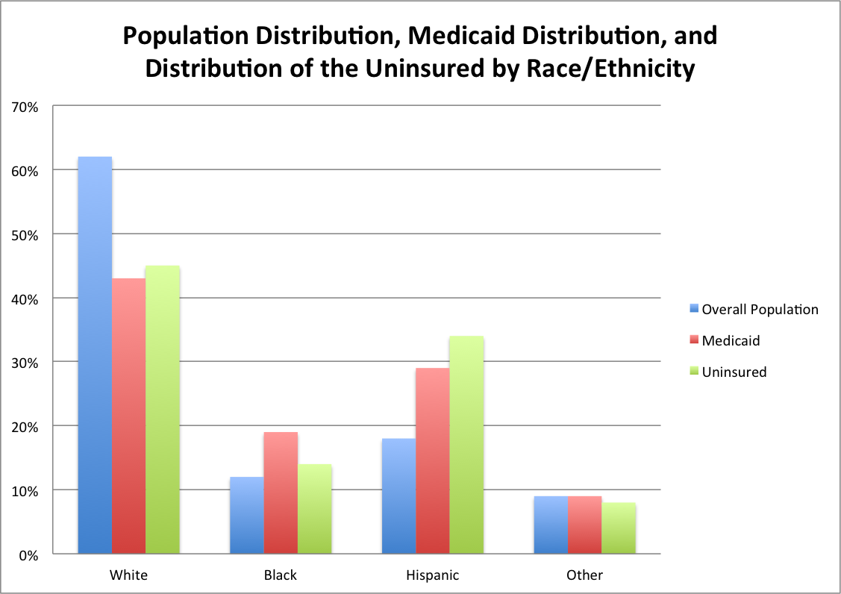
source: Kaiser Family Foundation http://kff.org/statedata/

Slide 19
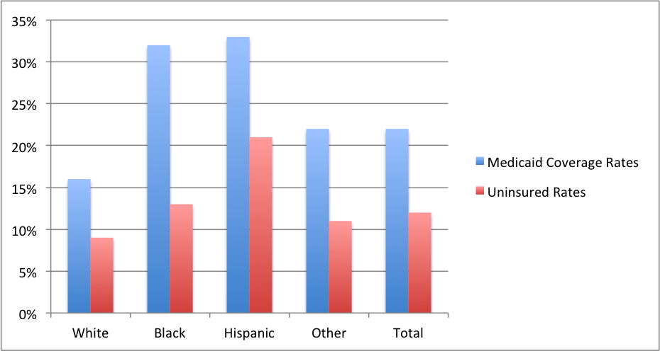

Slide 20
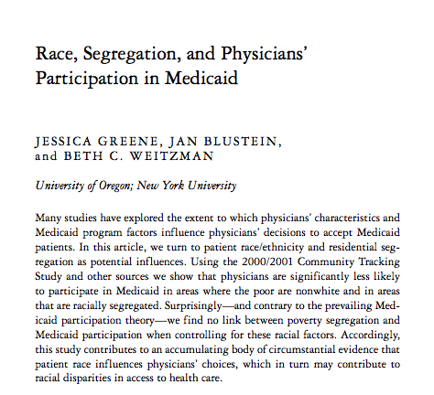

Slide 21
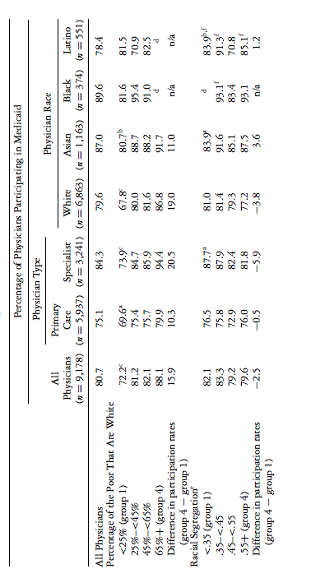

Slide 22
We participate in this every day:
Segregated Care at Mount Sinai
Insurance status is a major mechanism to perpetuate racism in health care -- to provide worse care to people of color
Table 1. Appointment wait times in days
 |  | FPA |  | IMA
 |  | Mean |  | Mean
Primary Care |  | 3.3 |  | 20.8
Dermatology |  | 2.8 |  | 50.5
Endocrinology |  | 29.3 |  | 54.0
GI |  | 24.0 |  | 69.0
Orthopedics |  | 7.8 |  | 77.3
Total |  | 13.4 |  | 54.3

Slide 23
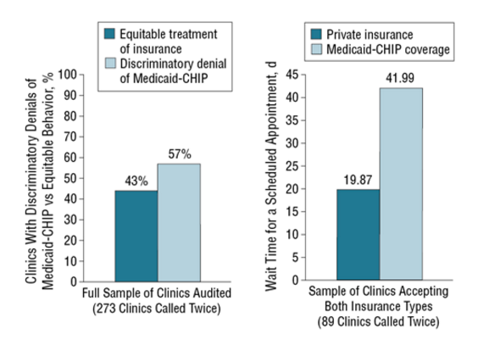
Segregated care at Academic Medical Centers
Academic medical centers and equity in specialty care access for children.
Bisgaier J1, Polsky D, Rhodes KV.
Notes:
http://archpedi.jamanetwork.com/article.aspx?articleid=1148401
RESULTS:
Of the 273 paired calls to clinics, 155 (57%) resulted in discriminatory denials of Medicaid-CHIP. The odds of a discriminatory denial were 45% lower if a clinic was AMC affiliated (odds ratio, 0.55; 95% CI, 0.31-0.99). On average, academic clinics scheduled Medicaid-CHIP appointments with wait times 40 days longer than private insurance (β, 40.73; 95% CI, 5.06-76.41).
CONCLUSIONS:
Affiliation with an AMC was associated with fewer discriminatory denials of children with Medicaid-CHIP. However, children with Medicaid-CHIP had significantly longer wait times at AMC-affiliated clinics compared with privately insured children. Academic medical centers' propensity toward serving publicly insured patients makes them candidates for targeted resource allocation, perhaps with incentives contingent on equitable appointment acceptance and wait times.

Slide 24
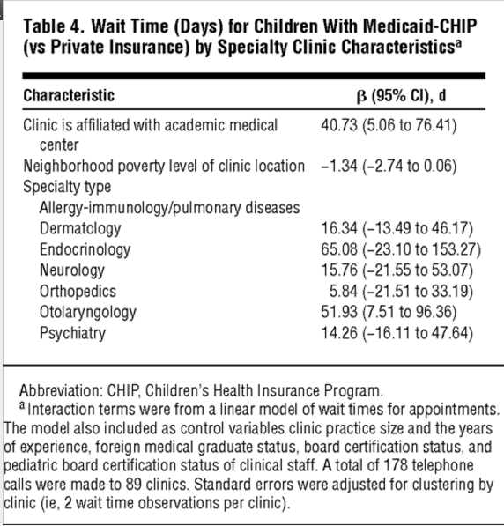

Slide 25
Segregation in health care is intentional and rampant
From David Barton Smith’s report on “Eliminating Disparities in Treatment and the Struggle to End Segregation”:
Health care remains quite segregated and may be becoming more so.
How health care is regulated and financed shapes the degree of segregation and disparities in treatment.
Segregation produces a health system that increases the cost and reduces the quality of care for everyone.
Segregation exaggerates disparities.

Slide 26
Discussion
How does the current health care system affect (constrain) our ability to provide equitable medical care?
How do we better incorporate racial justice into our arguments for single payer?
Notes:
Healthcare system is borne out of racism and also perpetuates it

Slide 27
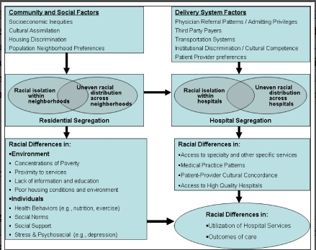

Slide 28
Vision for the Future
We cannot fight for single payer without concurrently fighting against racism.
We should better articulate how the current health care system is a powerful mechanism in our society to devalue the lives of people of color.
We must centralize discourse regarding racism in the current medical system in our efforts to explain why single payer is necessary.
Without these efforts, we may be repeating history.
Notes:
We have shown that racism exists in the current medical system and that in order to have an anti-racist medical system we need single payer, but we cannot achieve that simply by arguing for single payer without recognizing that racism exists in our current medical system and that is a major barrier to achieving a single-payer system.

